Slide 1
PCM
1375003
KyungSil Kim
ks_tina@naver.com
Department of Electronics Engineering
Ewha Womans University

Slide 2
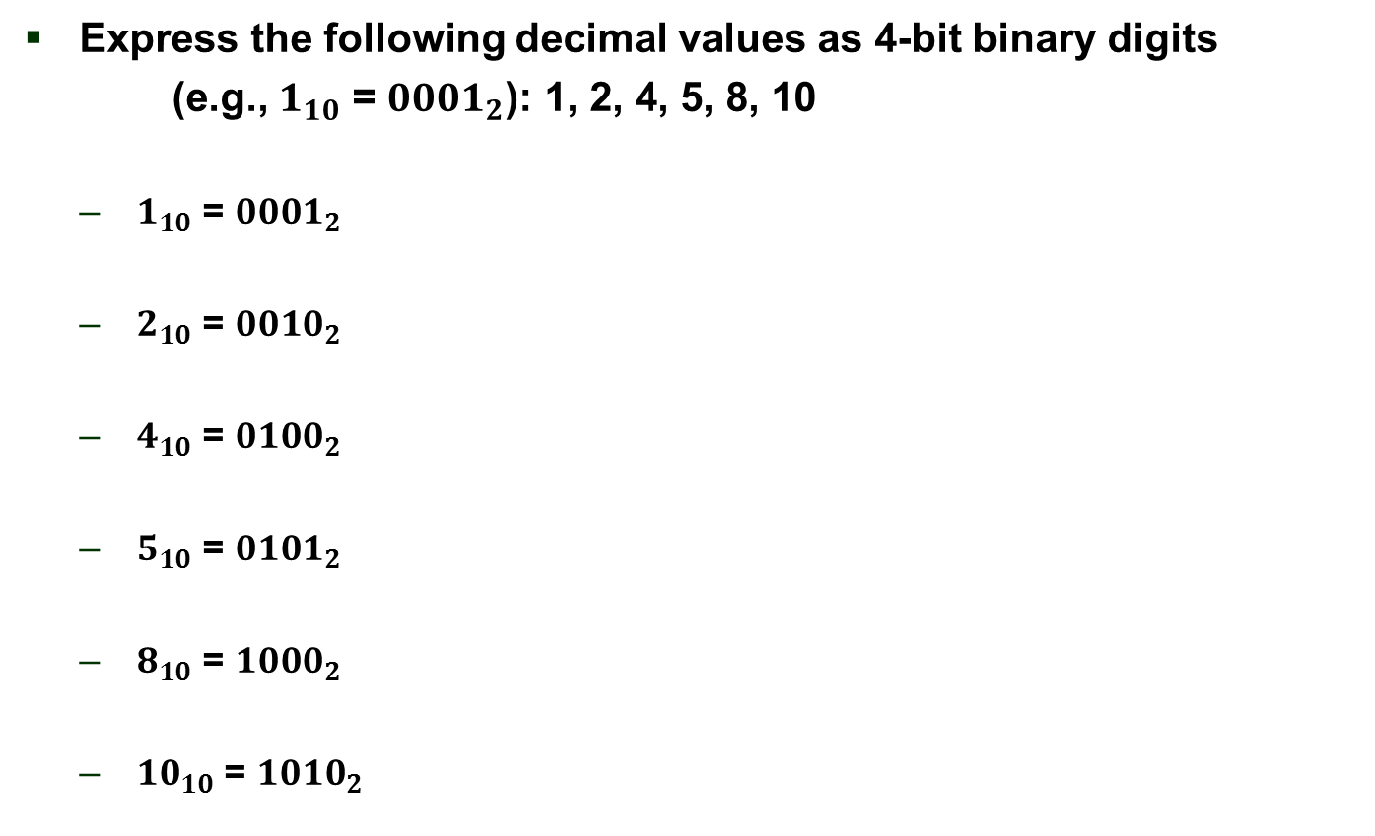
1.
Express the following decimal values as 4-bit binary digits
(e.g., $1_{10}$ = ${0001}_{2}$): 1, 2, 4, 5, 8, 10
  $1_{10}$ = ${0001}_{2}$
  $2_{10}$ = ${0010}_{2}$
  $4_{10}$ = ${0100}_{2}$
  $5_{10}$ = ${0101}_{2}$
  $8_{10}$ = ${1000}_{2}$
  ${10}_{10}$ = ${1010}_{2}$

Slide 3
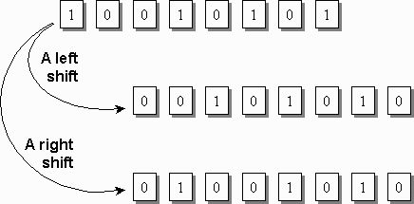
2. What are the effects of “right bit-shift” and “left bit-shift” in binary expression?
Left bit-shift
  Doubles the integer value
Right bit-shift
  Divides the integer value in half

Slide 4
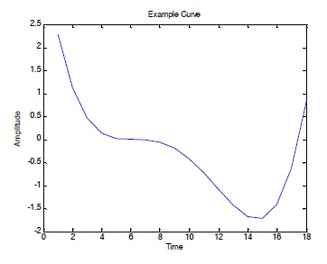
3. 2-bit PCM
11
10
01
00

Slide 5
3. 3-bit PCM
111
110
101
100
011
010
001
000

